Slide 1
Let’s Talk about College!
College Connection 2020-2021

Slide 2
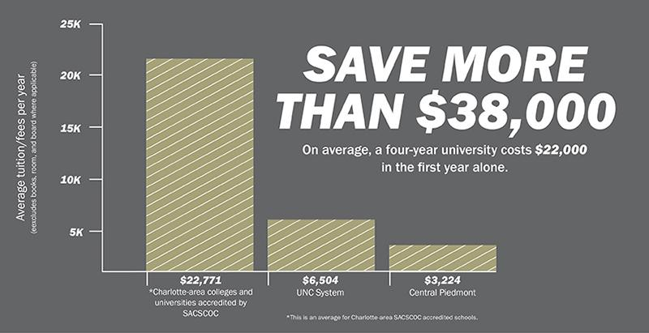
Why should you consider Central Piedmont Community College
3-C’s
Cost
Career
College
Career Fields - https://www.calameo.com/read/000876273447b8467746f
College Transfer – https://www.cpcc.edu/academics/transfer

Slide 3
What is College Connection
An opportunity for students to receive guidance and instruction through the application, R.I.S.E., registration and enrollment process in advance of other students.
CPCC Application / CFNC
R.I.S.E (Reinforced Instruction for Student Excellence) (Transcript)
Mandatory deadlines to participate
January 29 2021 – Application & Residency
April 17 2021 – Mandatory Orientation & Advising
May 30, 2021 – FAFSA & CP Scholarships (If Applicable) & Decision Made
Express Priority Registration (Student Placement Account)
NOTE: It is an opportunity for 12th graders to register for classes before graduating high school.

Slide 4
Why Participate
Provide opportunities for students to complete the registration and enrollment process in advance of other students.
It’s a Major Decision sessions – Explanation of Career Options
https://www.cpcc.edu/events/its-major-decision-workshop
Required Advising with classmates – Virtual Sessions
Required Orientation with classmates – Virtual Sessions
Enrollment before regular orientation – Beginning April 2021
Direct Assistance with FAFSA & Scholarships
Awarded Financial Aid earlier in process
NOTE: It is an opportunity for 12th graders to register for classes before graduating high school.

Slide 5
CPCC Resource Sites
Important Websites:
Application & NC Residency https://www.cfnc.org / https://NCResidency.org
Enroll @ Central Piedmont https://www.cpcc.edu/admissions/enroll
Visit Central Piedmont https://www.cpcc.edu/admissions/visit
Financial Aid and Scholarships https://www.cpcc.edu/financial-aid/scholarships
Career and College Promise Program https://www.cpcc.edu/programs/dual-enrollment
Year Up https://www.yearup.org/about-us/our-locations/charlotte/
49erNext Program https://www.cpcc.edu/academics/academic-resources/transfer/unc-charlotte/49ernext

Slide 6
Ask your Engagement Specialist
Timothy Graham
Timothy.graham@cpcc.edu
704.330.4627

