Slide 1
Job & Career Readiness Training
Omar Crenshaw
Youth Programs Specialist
City of Charlotte
Housing & Neighborhood Services
Community Engagement Division
Youth Programs
Notes:
Welcome & Thank You

Slide 2
AGENDA
Introduction
JCRT Recruitment
JCRT Timeline
Curriculum
Training Dates
MYEP Application / Process
Questions
Notes:
AGENDA

Slide 3
JCRT RECRUITMENT
CDC promotes opportunity to students using flyer
Student register on their own using the registration link
Registration Deadline Wednesday September 30th at 11:59pm
JCRT Training Window Opens Friday October 2nd
Notes:
AGENDA

Slide 4
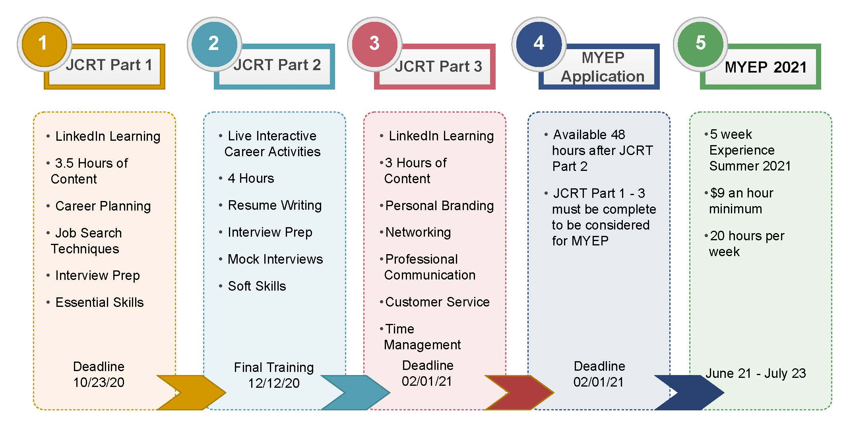
JCRT TIMELINE
Notes:
AGENDA

Slide 5
Curriculum
City of Charlotte Curriculum
LinkedIn Learning Access
FULL ACCESS
Videos, Trainings, Certifications
Interactive, Exploratory, Engaging
Notes:
SOURCES OF CURRICULUM

Slide 6
GOALS FOR TRAINING
Discover personal traits and characteristics that can assist with career clarity
Know where and how to find career information
Increase self-awareness
Increase knowledge of career planning tools and tactics
Understand how goal setting plays a role in career success
Improve written, verbal and nonverbal communication skills
Enhance general customer service skills
Increase understanding of basic money management and budgeting
Expose students to appropriate usage for social media and technology in the workplace
Understand how to prepare for different types of interviews
Expose students to professional networking tools and strategies
Understand time management techniques that improve productivity
Improve soft skills
Notes:
GOALS

Slide 7
CURRICULUM
JCRT PART 1
3.5 hours of virtual learning
To be completed between 10/2 and 10/23
Students sent weekly reminders to complete
Content prepares for Phase 2
Notes:
LiL Preview

Slide 8
CURRICULUM
JCRT PART 2
4 hours of live career based training
To be completed between 11/2 and 12/12
120 students per session
Interactive activities to reinforce virtual learning
Notes:
LiL Preview

Slide 9
CURRICULUM
JCRT PART 3
3 hours of virtual learning
Access begins 12/12/20
Deadline 2/1/20
Students sent weekly reminders to complete
Completion marks completion of JCRT
Notes:
LiL Preview

Slide 10
TRAINING DATES
Date | School
11/2/2020 | West Meck / Harding
11/4/2020 | Independence / Rocky River
11/6/2020 | CCA / Olympic
11/7/2020 | Community Training
11/10/2020 | Myers Park / North Meck
11/12/2020 | Ardrey Kell / Garinger / Performance Learning Center
11/14/2020 | Community Training
11/16/2020 | Vance/ Turning Point / Olympic
11/18/2020 | Hopewell / Hawthorne
11/20/2020 | Providence / Hough
11/30/2020 | West Charlotte / Northwest / Virtual High School
12/2/2020 | Mallard Creek / CEEC
12/4/2020 | CPCC / South Meck
12/7/2020 | East Meck / Butler
12/9/2020 | Phillip O. Berry
12/12/2020 | Last Chance Training / Community
Notes:
AGENDA

Slide 11
MYEP APPLICATION
Rolling Basis Availability of Application (Final Deadline: 2/1/2021)
The application will be made available to those students who have completed the training on a rolling basis (i.e. School A trains 11/2 and application is made available with 24-48 hours after training)
Deadline for all applications is Monday February 1, 2021 (11:59 p.m.)
Every candidate will have at least seven weeks to complete their application
Notes:
AGENDA

Slide 12
PROGRAM OVERVIEW: Requirements
MYEP PROGRAM REQUIREMENTS
Be 16 years of age on or before April 15, 2021.
Currently enrolled in a high school and attend a CMS high school and/or reside in the City of Charlotte.
Complete the City of Charlotte’s Job and Career Readiness Training
Submit online application, interview, and supporting documents to the MYEP by February 1, 2021.
Have a social security number and be eligible to work in the United States.
Pass a background check and drug screening (additional details will be provided to MYEP candidates)
Notes:
As our program grows to serve more participants, our team is continuously working to identify processes that are effective in meeting the needs of all MYEP stakeholders. For instance, this year we incorporated a career classification system to more accurately match MYEP participants with host employers based on participants’ expressed career interests. Also, we began the matching process much earlier than in prior years. This enabled our team to communicate placement offers to students on Friday, May 18, 2020 with a set deadline to accept or decline their position by Friday, May 22, 2020.
In determining participant placements, the MYEP team considered multiple factors, such as the strength of application and interview, expressed career interests, extracurricular involvement, specific job or candidate requirements articulated by the host employer, as well as the proximity of the student to the work location and the participant’ access to transportation.
MYEP participants were intentionally matched with host employers based on their unique qualities and circumstances, as well as the availability of host employer positions that aligned to a participant’s expressed career interests. In some cases there was not a perfect match; however, we believe there is still significant value in the participants’ opportunity to have a work-based experience and we encourage participants to keep an open mind about their experience.
Host employers were asked to reach out to their assigned MYEP students by June 22nd. If you have not heard from your host employer, please contact us at:
MYEP@ci.charlotte.nc.us
(Next Slide)

Slide 13
PROGRAM OVERVIEW: The Matching Process
KEY CONSIDERATIONS:
Strength of application and interview
Expressed career interests
Extracurricular involvement
Specific job or candidate requirements articulated by the host employer, and
Proximity of the student to the work location and the students’ access to transportation (as expressed in their MYEP application)
Notes:
As our program grows to serve more participants, our team is continuously working to identify processes that are effective in meeting the needs of all MYEP stakeholders. For instance, this year we incorporated a career classification system to more accurately match MYEP participants with host employers based on participants’ expressed career interests. Also, we began the matching process much earlier than in prior years. This enabled our team to communicate placement offers to students on Friday, May 18, 2020 with a set deadline to accept or decline their position by Friday, May 22, 2020.
In determining participant placements, the MYEP team considered multiple factors, such as the strength of application and interview, expressed career interests, extracurricular involvement, specific job or candidate requirements articulated by the host employer, as well as the proximity of the student to the work location and the participant’ access to transportation.
MYEP participants were intentionally matched with host employers based on their unique qualities and circumstances, as well as the availability of host employer positions that aligned to a participant’s expressed career interests. In some cases there was not a perfect match; however, we believe there is still significant value in the participants’ opportunity to have a work-based experience and we encourage participants to keep an open mind about their experience.
Host employers were asked to reach out to their assigned MYEP students by June 22nd. If you have not heard from your host employer, please contact us at:
MYEP@ci.charlotte.nc.us
(Next Slide)

Slide 14
QUESTIONS
Omar Crenshaw
Youth Programs Specialist
PHONE: 704-336-2118 omar.crenshaw@charlottenc.gov

